Slide 1


A
Industrial Training
On
Python development from
Simplilearn by skill up
Submitted To:
Dr. Renu Bagoria HOD. Of B.Tech (CSE)
Submitted By:
Hritik singh
Class Roll. 66
Enroll no. 0201230163 B.Tech 3rd Yr. CSE

Slide 2
ABOUT SIMPLILEARN
Simplilearn is a global online education platform that provides digital skills training and professional certification programs to individuals and corporations.
It offers a wide range of courses in areas like data science, cloud computing, cybersecurity, and digital marketing, often developed in partnership with universities and industry experts. The company uses a blend of live classes, on-demand courses, and hands-on projects to help learners upskill for careers in the digital economy.
Headquarters: San Francisco, California, and Bangalore, India
Founding: Founded in 2010 by Krishna Kumar, Archana Kumari, and Kashyap Dalal.
Partnerships: Collaborates with universities and top companies to create industry-relevant curricula and offer globally recognized credentials

Slide 3

CERTIFICATE OF COMPLITION

Slide 4
COURSE OUTCOME
Introduction Python Development.
Apply Control Structures
Work with Data Structures
Modular & Functional Programming
File Handling & Exceptions.
Object-Oriented Programming
Work With Libraries
Develop Real-World Applications

Slide 5
PROJECT (scientific calculator )
Features
• Basic Arithmetic Operations
  • Scientific Functions: sin, cos, tan, log, ln, sqrt, factorial
  • Memory Functions: M+, M-, MR, MC
  • Safe Expression Evaluation
  • GUI Built Using Tkinter

Slide 6
.
Technology Used
.
Component | Description
Language | Python
Library | Tkinter (for GUI)
Functions | eval(), Entry widget, Button widget
IDE | VS Code

Slide 7
How to Use
Run the Python program.
The calculator window will appear.
Click on number and operator buttons to form an equation.
Press = to see the result.
Use C to clear the screen.

Slide 8
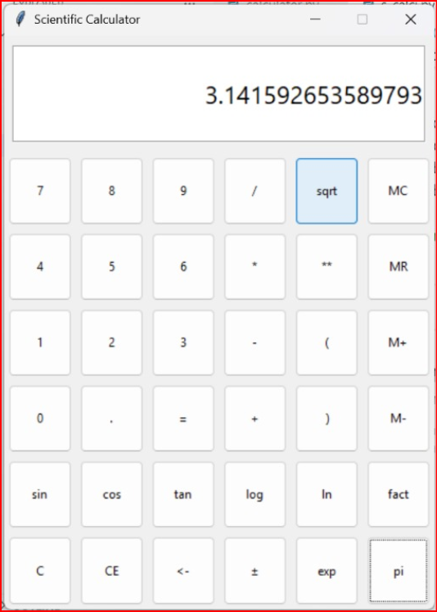
Step 1: User Interface
When the program runs, this calculator window appears with buttons fornumbers (0–9) and operators
A display box (Entry widget) is used to show user input and results.

Slide 9
Step 2: Input Handling
When the user clicks on a number or operator button, that value is inserted into the display box.
The click() function is used to capture the button event.

Slide 10
Step 3: Expression Evaluation
When the user presses the “=” button:
  The entered mathematical expression is taken from the display.
  It is passed to Python’s built-in eval() function.
  The result is calculated and shown on the display.
  Step 4: Error Handling
If the user enters an invalid expression, the program displays “Error”.
The “C” (Clear) button clears the screen for new input.

Slide 11
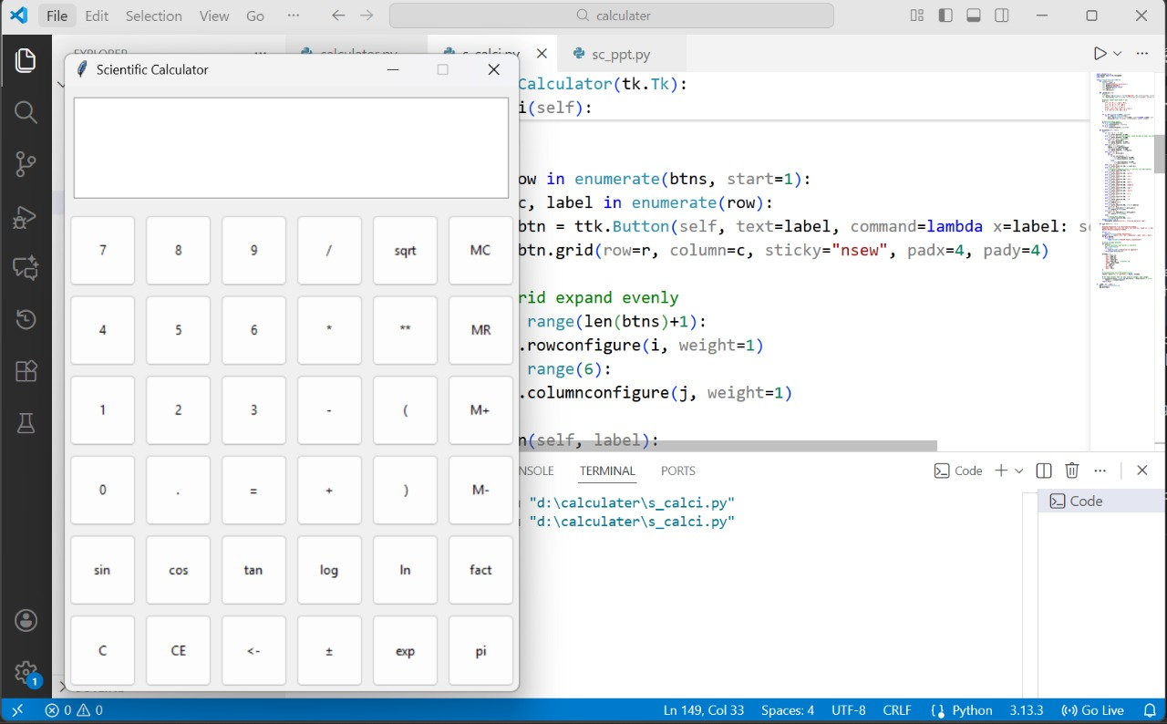
Image of project

Slide 12
🔍 Key Features
✅ Easy to use GUI
✅ Handles all basic arithmetic operations
✅ Clear button for correction
✅ Error handling for invalid input

Slide 13
Thank You

